Slide 1

CPE 490 Embedded Systems Lecture 15
Void pointers
Pointers to functions
FreeRTOS
Much of this presentation comes from www.freertos.org tutorial
As well as “Using the FreeRTOS Real Time Kernal, A Practical Guide”, Richard Barry, 2010 version 1.3.2.

Slide 2
Void Pointers
A void pointer is a pointer to data that is of a yet to be determined data type
It can be cast to point to any data object you would like .
It is useful in passing parameters of different variable types into a function

Slide 3
Example of void pointer
#include
void main()
{
int a=10;
float b=35.75;
void *ptr; // Declaring a void pointer
ptr=&a; // Assigning address of integer to void pointer.
printf("The value of integer variable is= %d",*( (int*) ptr) );// (int*)ptr - is used for type casting. Where as *((int*)ptr) dereferences the typecasted void pointer variable.
ptr=&b; // Assigning address of float to void pointer.
printf("The value of float variable is= %f",*( (float*) ptr) );
}
This code is from http://www.circuitstoday.com/void-pointers-in-c

Slide 4
Example of Void Pointer in Function
void funct(void *a, int z) { if(z==1) printf("%d",*(int*)a); // If user inputs 1, then he means the data is an integer and type casting is done accordingly. else if(z==2) printf("%c",*(char*)a); // Typecasting for character pointer. else if(z==3) printf("%f",*(float*)a); // Typecasting for float pointer }

Slide 5
Pointer to Functions
Since a function is located at an address in program memory you can construct a pointer to the function
This feature allows you to pass a function into a function based upon need. It also lets you assign a function based upon say an input and then forevermore use that function once the input has been determined

Slide 6
Example of Using a Function Pointer
int DoIt (float a, char b, char c)
{ return a+b+c; }
int DoMore(float a, char b, char c)
{ return a-b+c; }
int main(void) {
int (*pt2Function)(float, char, char) = 0;
int d; char a =2,b=1,c=0;
pt2Function = DoIt; // short form
d = (*pt2Function)(a,b,c); //calling the function using a pointer
pt2Function = &DoMore; // correct assignment using address //operator
d = (*pt2Function)(a,b,c);

Slide 7
qsort function
void qsort( void *start, size_t length, size_t size, int (*compare)(const void *, const void *));
Where start is a pointer to an array
length is the length of the array
size is the number of bytes wide
compare is a pointer to function
Notes:
size_t is really an unsigned int (How can you accomplish this in C?)

Slide 8
Passing a Function to a Function
int comp(char *a, char *b);
main()
{ char str[] = “this is a test”;
qsort(str, strline(str), 1, comp);
}
int comp(char *a, char *b)
{ return *a -*b;}
Notes:
qsort is a standard C function and is prototyped
void qsort( void *start, size_t length, size_t size, int (*compare)(const void *, const void *));
To use qsort() you must pass it a pointer to the start of the array of objects you wish sorted in start, the length of the array in length, the width of each element (in bytes) in size, and a pointer to a comparison function. The sorted string is placed in start.
qsort could be used to sort integers if you wanted. In this case the comp function could be defined to take integers

Slide 9
FreeRTOS Task Priority
Every task has a priority, the lowest being 0, the priority of the idle task.
The scheduler will always ensure the highest priority task that is able to run is the task selected.
If multiple task that are ready to run are set at the highest priority then the tasks will all get an equal time slice of the processor.

Slide 10
How the FreeRTOS Scheduler Works
Each task is assigned a priority when it is created. Other tasks can change the priority of any other task but the kernel can not.
Each task can exist in one of several states. More on this later but the state can be combined into ready to run or not.
Only one task can exist in the running state at one time.

Slide 11
The kernel or schedule works out of a periodic timer ISR called the tick interrupt.
Every interrupt is a time tick that is counted. The highest priority task that is ready is then run until the task blocks itself or the tick interrupt occurs again.
If the task (Task A) that was running before the tick interrupt is not the task (Task B) that runs after the interrupt then Task B pre-empts Task A
If two or more tasks have the same priority and are ready they will be executed in a round robin fashion

Slide 12
Classification of FreeRTOS Scheduler
Fixed Priority Pre-emptive Scheduling
Fixed Priority: each task is assigned a priority at creation, or it can be changed in a task but it is never changed in the kernel.
Pre-emptive: a task entering the ready state will always pre-empt a running task of a lower priority.

Slide 13
User Written Task function
Prototype:
void ATaskFunction( void *pvParameters);
Example
void ATaskFunction(void *pvParameters)
{
int iVariableExample = 0;
for ( ; ;)
{
//code implementation goes here
}
vTaskDelete( NULL );
}
Notes:
The prototype must be followed, in that the function can return nothing and the there is only one void pointer as a parameter (this could give you access to many variable).
You can declare variables in the function as normal but you can not declare an variable static. The reason is that you could create more than one instances of the task function when create API is used (more on this later).
A task is normally implemented as an infinite loop it will hog the processor until it at interrupt tick it is preempted or it puts itself asleep, by blocking (more on this later). Do not put a return statement into this code.
It a task should ever exit the for loop then it must destroy itself before the task returns.

Slide 14
Creating a Task
Prototype:
portBase_Type xTaskCreate(
pdTASK_CODE pvTaskCode,
const signed char * const pcName
unsigned short usStackDepth,
void *pvParameters,
unsigned portBASE_TYPE uxPriority,
xTaskHandle *pxCreatedTask
);
Notes:
pvTaskCode – a pointer to the function that implements the task see previous slid it would be a pointer to ATaskFunction.
pcName is a string that describes the task, this is not used by the kernel and is used for debugging purposes only
usStackDepth is a an integer (16 bits) that describes the stack size, in words (16 bits) that will be reserved for this instance of the task. This is a guess but the minimum size declared in the demo is 105 bytes. In reality you will take a guess and then use given tools to track the stack usage.
pvParameters the task function does have this parameter in its input list you can use this pointer to make the correct instance of the task. This just initializes function because it will only be called once.
uxPriority this gives the priority of the task in our case the priority starts a zero and goes up to 3 so when creating a task the priority should be 1,2, or 3.
pxCreated Task is used to pass a handle to the kernal to an integer that will be assigned by the task creator, you then can use this handle in other API function calls like delete a task.
Return value is an integer either pdTRUE (this is an integer 1) or errCOULD_NOT_ALLOCATE_REQUIRED_MEMORY = -1
Types
portBASE_TYPE: Defined as the most efficient data type for the architecture (for dsPIC33 that would be 16 bit or integer.

Slide 15
Example Make 2 Instances of the Task
static const char *pcTextForTask1 = “Task 1 is running \r\n”;
static const char *pcTextForTask2 = “Task 2 is running \r\n”;
int main( void ) {
xTaskCreate( vTaskFunction, “TSK 1”, 1000, (void*) pcTestForTask1, 1, null);
xTaskCreate( vTaskFunction, “TSK 2”, 1000, (void*) pcTestForTask2, 1, null);
vTaskStartScheduler();
for( ; ; );
}
Notes:
In this main code we create 2 instances of the same task but by feeding different char string we will print two different messages.
It is important that these strings are permanent so they are declared static const, I believe we could get away with just making them const with our compiler
Each task function is defined by vTaskFunction, they have different dbug tags, the same 1000 byte stack space (most likely way too big), the string passed to the function (notice how the char pointer is cast to be void pointer), with priority level 1, and finally no handle is passed.
The for loop is only if VTaskStartScheduler would fail because of the lack of resources, so if you end up trapped in the for loop you know something has gone wrong.

Slide 16
Example Declare a Task
void vTaskFunction( void *pvParameters)
{
char *pcTaskName;
volatile unsigned long ul;
pcTaskName = ( char * ) pvParameters;
for ( ; ; ) {
vPrintString(pcTaskName);
for ( ul = 0; ul < mainDelay_Loop_Count; ul++)
{
}
}
}
Notes:
This follows the prototype we just saw
The pvParameters is a void pointer, we cast it to be a character pointer and then use it print out a string.
The infinite loop is proper for a task as we discussed
The for loop is a delay, that is very inefficient.

Slide 17
Continuous Processing Tasks
They never block them selves (more in this later)
Rule: If the lowest priority is 0 and a continuous process tasks has a non zero positive integer value of X then all priorities less than X will never run.

Slide 18
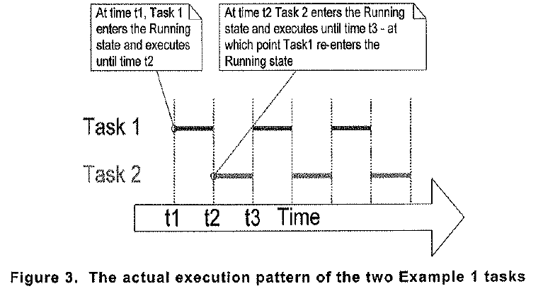
Example Timing Diagram
Notes:
Both of the tasks are examples of continuous tasks that is they never are blocked waiting for an event. These tasks will continue to run, never letting a task at priority 0 (the idle task) to run.

Slide 19
Tick Interrupt
To be able to select the next task to run, the scheduler itself must execute at the end of each time slice.
A periodic interrupt called the tick interrupt is created this is how the scheduler runs at the end of each time slice
The tick interrupt frequency is defined as configTICK_RATE_HZ while the period in milliseconds is defined as portTICK_RATE_MS
The tick count is the total number of tick interrupts. Tasks don’t worry about roll over as it is already taken care of in the kernel.
Notes:
In the demo program for the dsPIC the frequency is set at 1000 Hz or every 1 ms. ConfigTICK_RATE_HZ is defined FREERTOSCONFIG.h

Slide 20
Tick Interrupt Frequency Tradeoff
The higher the frequency the less efficient the code that is the interrupt latency becomes are greater percentage of run time of the processor
The lower the frequency to the lower the resolution of control. Pre-emptive task switching can only happen at the tick interrupt.

Slide 21
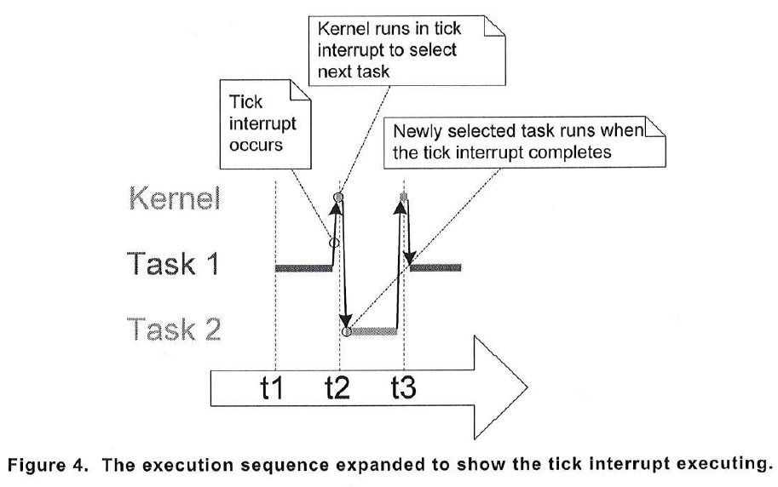
Graphical Example of Tick Interrupt

Slide 22
Starving a Task
If task 2 has a higher priority then task 1 and task 2 is continuous task it will never relinquish control to task 1.
In this case task 2 starves task 1. We can see that it would be good if task 2 could go to sleep or be blocked for a period of time or until an event occurs.

Slide 23
Blocked State
A task that is waiting for an event is said to be in the blocked state, a subset of the not running state,
A task can be waiting for two different types of events:
Time related event, periodic or absolute time
Synchronization event that originates from another task or an interrupt. These events are communicated through queues, and semaphores.
The task puts itself into the blocked state

Slide 24
Suspended State
A task is suspended through an API call:
vTaskSuspend()
The only way it can come out of suspension is to make an API call:
vTaskResume()
Most application do not use the suspend state

Slide 25
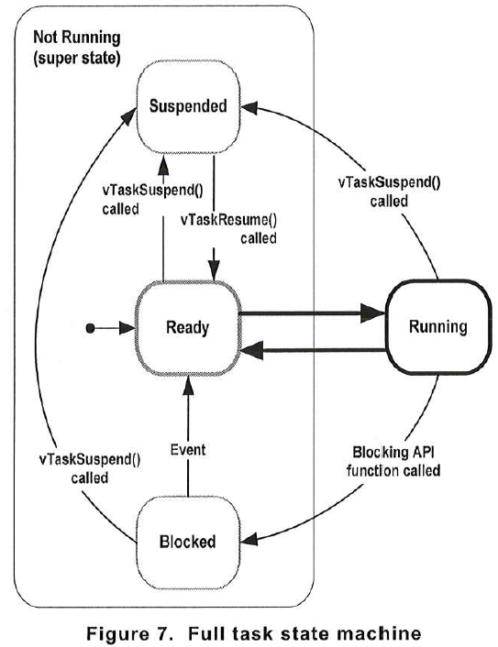
Task State Machine

Slide 26
Time Delays Using APIs
There are two different API function calls to block a task.
vTaskDelay
vTaskDelayUntil

Slide 27
vTaskDelay()
Prototype
Void vTaskDelay( portTickType xTicksToDelay);
Where xTicksToDelay is the number of tick interrupts that the calling task should remain in the blocked state before going back to the ready sate
Notes:
This is an absolute delay from the time that it is called.

Slide 28
Example Task Using Blocking State
void vTaskFunction( void *pvParameters ) {
char *pcTaskName;
pcTaskName = (char *) pvParameters;
for ( ; ; ) {
vPrintString( pcTaskName );
vTaskDelay( 250 / portTICK_RATE_MS );
}
}
Notes:
portTICK_RATE_MS is going to be the number of milliseconds in on clock tick. The delay will be for 250 ms. Therefore this task will be blocked for 250 ms.

Slide 29
vTaskDelayUntil()
This is used when we want a task to be called periodically.
It will record the current tick time when the API is unblocked and apply the time delay to this time. In this way the time it takes to execute the task is not a factor.
Notes:
The other delay will only occur from moment you block and can not promise periodic behavior unless the code run time is always exactly the same.

Slide 30
vTaskDelayUntil()
void vTaskDelay”Until( portTickType * pxPreviousWakeTime, portTickType xTimeIncrement);
pxPreviousWakeTime is the time tick accumulated count when the task was called.
xTimeIncrement is an integer that sets the period of periodic calling of the task. Its units are time ticks
Notes:
Details are somewhat complicated so we will skip them.

Slide 31
void vTaskFunction( void *pvParameters )
{
char *pcTaskname;
portTickType xLastWakeTime;
pcTaskName = ( char * ) pvParameters;
/* The xLastWakeTime variable needs to be initialized with the current tick count. Note that this is the only time the variable is written to explicitly. After this xLastWakeTime is updated automatically internally within vTaskDelayUntil(). */
xLastWakeTime = xTaksGetTickCount();
/* As per most tasks, this task is implemented in an infinite loop. */
for( ;; )
{
/* Print out the name of the task. */
vPrintString( pcTaskNAme );
/* This task should execute exactly every 250 ms. As per the VTaskDelay() function, time is measured in ticks, and the portTICK_RATE_MS constant is used to convert milliseconds into ticks. xLastWakeTime is automatically updated within vTaskDelayUntil() so is not explicitly updated by the task. */
vTaskDelayUntil( &xLastWakeTime, (250 / port_TICK_RATE_MS);
}
}

Slide 32
Example Task Creation Using Blocking State
static const char *pcTextForTask1 = “Task 1 is running \r\n”;
static const char *pcTextForTask2 = “Task 2 is running \r\n”;
int main( void ) {
xTaskCreate( vTaskFunction, “TSK 1”, 1000, (void*) pcTestForTask1, 1, null);
xTaskCreate( vTaskFunction, “TSK 2”, 1000, (void*) pcTestForTask2, 2, null);
vTaskStartScheduler();
for( ; ; );
}
Notes:
In this case we made two instances of the task. Task 1 has a priority of 1 while Task 2 has a priority of 2. If the delay was not done by blocking task 1 would never run because task 2 would starve it. But since task 2 can now be blocked this opens time for task1 to run and since both tasks can be blocked the idle task will also run.

Slide 33
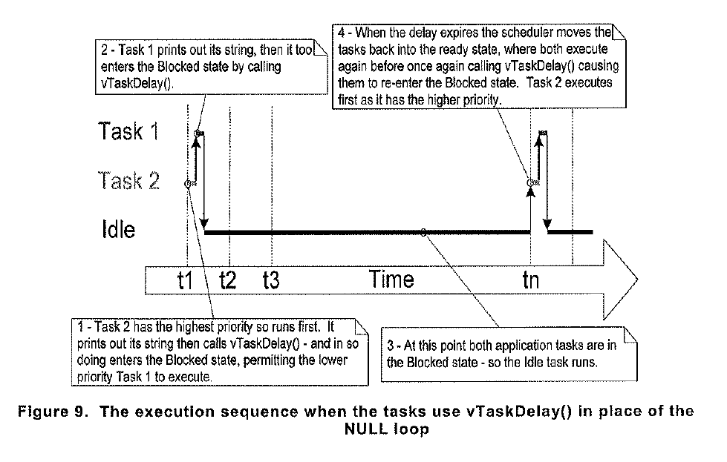
Timing Diagram

